Slide 1
Advanced Econometrics: Time Series
Topic 5
Cointegration – Practical Illustration

Slide 2
International Parity Relationships
We will investigate whether there is empirical evidence in support of two (of the several) international parity relationships predicted by arbitrage:
Purchasing Price Parity (PPP)
Uncovered Interest Parity (UIP)
These strong predictions have spurred on numerous empirical studies.
Typically, the evidence is weak, especially for PPP

Slide 3
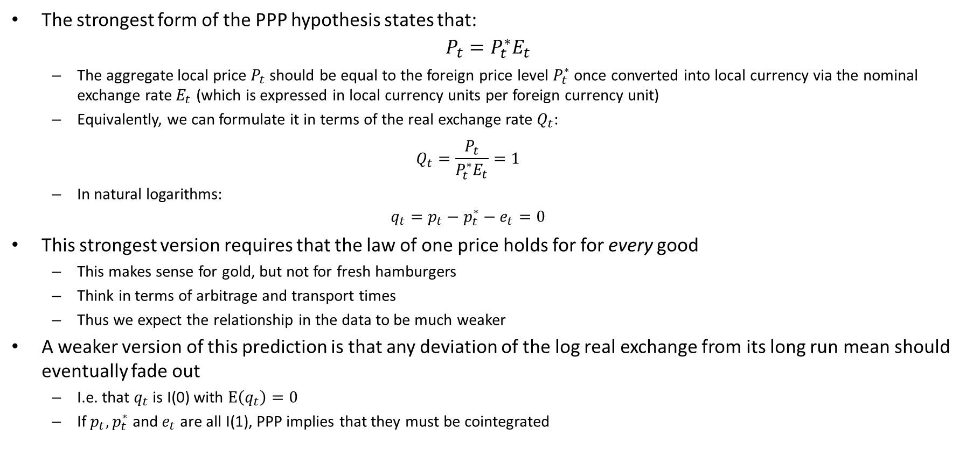
Purchasing Price Parity
The strongest form of the PPP hypothesis states that:
$$P_{t}=P_{t}^{∗}E_{t}$$
The aggregate local price $P_{t}$ should be equal to the foreign price level $P_{t}^{∗}$ once converted into local currency via the nominal exchange rate $E_{t}$ (which is expressed in local currency units per foreign currency unit)
Equivalently, we can formulate it in terms of the real exchange rate $Q_{t}$:
$$Q_{t}=\frac{P_{t}}{P_{t}^{∗}E_{t}}=1$$
In natural logarithms:
$$q_{t}=p_{t}−p_{t}^{∗}−e_{t}=0$$
This strongest version requires that the law of one price holds for for every good
This makes sense for gold, but not for fresh hamburgers
Think in terms of arbitrage and transport times
Thus we expect the relationship in the data to be much weaker
A weaker version of this prediction is that any deviation of the log real exchange from its long run mean should eventually fade out
I.e. that $q_{t}$ is I(0) with $E\left(q_{t}\right)=0$
If $p_{t},p_{t}^{∗}$ and $e_{t}$ are all I(1), PPP implies that they must be cointegrated

Slide 4
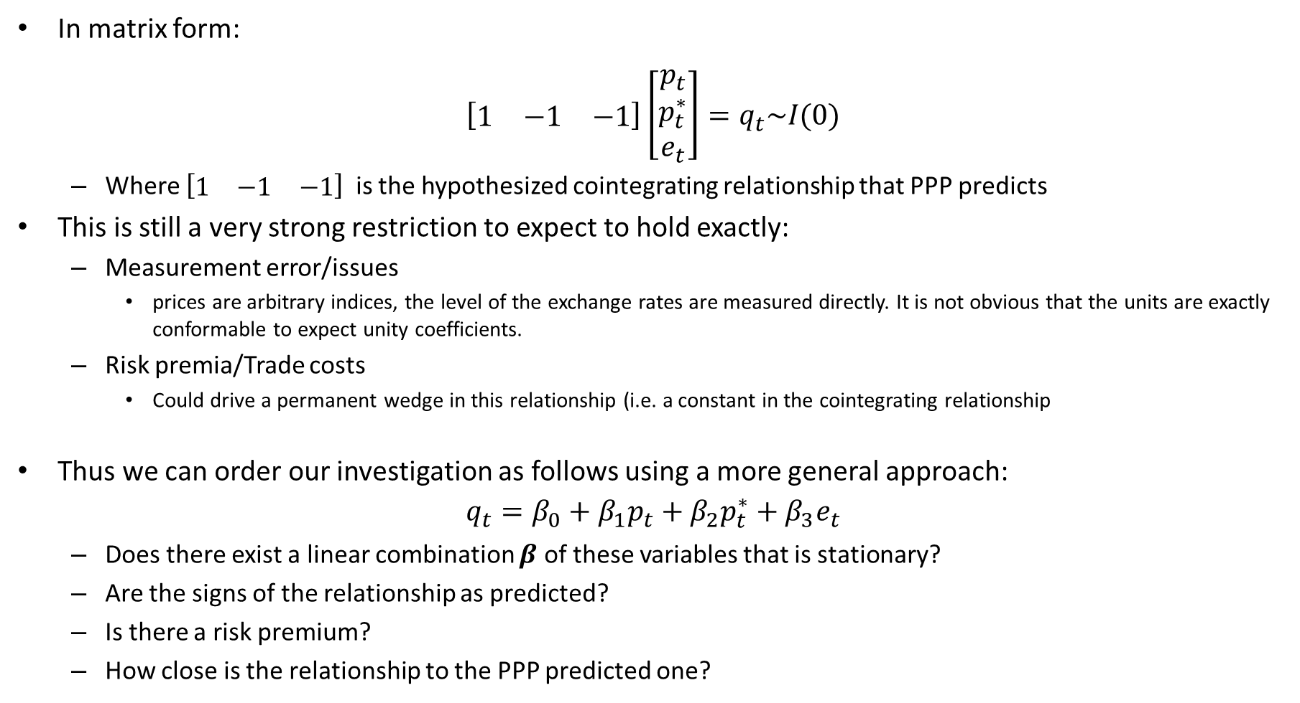
Purchasing Price Parity
In matrix form:
$$\left[\begin{matrix}1 & −1 & −1\end{matrix}\right]\left[\begin{matrix}p_{t} \\ p_{t}^{∗} \\ e_{t}\end{matrix}\right]=q_{t}\sim I(0)$$
Where $\left[\begin{matrix}1 & −1 & −1\end{matrix}\right]$ is the hypothesized cointegrating relationship that PPP predicts
This is still a very strong restriction to expect to hold exactly:
Measurement error/issues
prices are arbitrary indices, the level of the exchange rates are measured directly. It is not obvious that the units are exactly conformable to expect unity coefficients.
Risk premia/Trade costs
Could drive a permanent wedge in this relationship (i.e. a constant in the cointegrating relationship
Thus we can order our investigation as follows using a more general approach:
$$q_{t}=β_{0}+β_{1}p_{t}+β_{2}p_{t}^{∗}+β_{3}e_{t}$$
Does there exist a linear combination $β$ of these variables that is stationary?
Are the signs of the relationship as predicted?
Is there a risk premium?
How close is the relationship to the PPP predicted one?

Slide 5
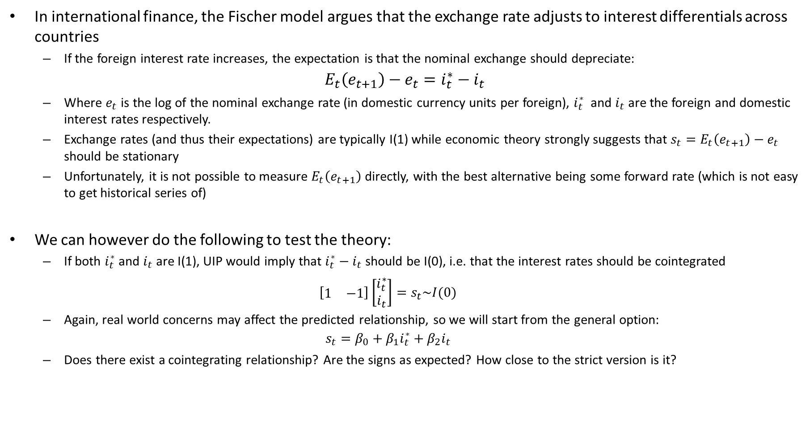
Uncovered Interest Parity
In international finance, the Fischer model argues that the exchange rate adjusts to interest differentials across countries
If the foreign interest rate increases, the expectation is that the nominal exchange should depreciate:
$$E_{t}\left(e_{t+1}\right)−e_{t}=i_{t}^{∗}−i_{t}$$
Where $e_{t}$ is the log of the nominal exchange rate (in domestic currency units per foreign), $i_{t}^{∗}$ and $i_{t}$ are the foreign and domestic interest rates respectively.
Exchange rates (and thus their expectations) are typically I(1) while economic theory strongly suggests that $s_{t}=E_{t}\left(e_{t+1}\right)−e_{t}$ should be stationary
Unfortunately, it is not possible to measure $E_{t}\left(e_{t+1}\right)$ directly, with the best alternative being some forward rate (which is not easy to get historical series of)
We can however do the following to test the theory:
If both $i_{t}^{∗}$ and $i_{t}$ are I(1), UIP would imply that $i_{t}^{∗}−i_{t}$ should be I(0), i.e. that the interest rates should be cointegrated
$$\left[\begin{matrix}1 & −1\end{matrix}\right]\left[\begin{matrix}i_{t}^{∗} \\ i_{t}\end{matrix}\right]=s_{t}\sim I(0)$$
Again, real world concerns may affect the predicted relationship, so we will start from the general option:
$$s_{t}=β_{0}+β_{1}i_{t}^{∗}+β_{2}i_{t}$$
Does there exist a cointegrating relationship? Are the signs as expected? How close to the strict version is it?

Slide 6
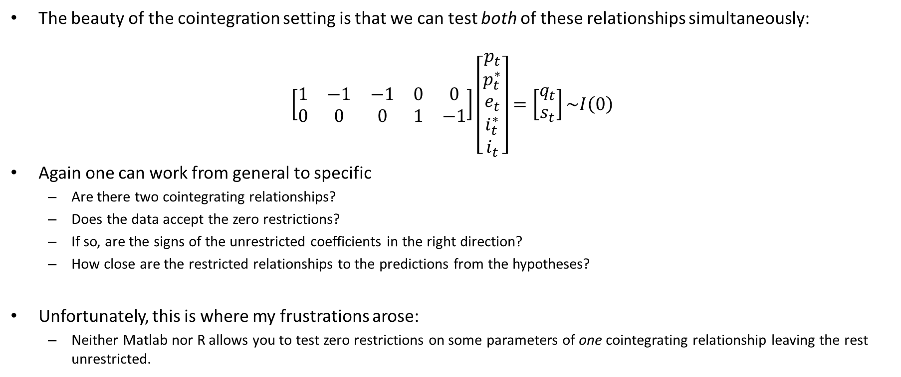
Joint testing
The beauty of the cointegration setting is that we can test both of these relationships simultaneously:
$$\left[\begin{matrix}1 & −1 & −1 & 0 & 0 \\ 0 & 0 & 0 & 1 & −1\end{matrix}\right]\left[\begin{matrix}p_{t} \\ p_{t}^{∗} \\ e_{t} \\ i_{t}^{∗} \\ i_{t}\end{matrix}\right]=\left[\begin{matrix}q_{t} \\ s_{t}\end{matrix}\right]\sim I\left(0\right)$$
Again one can work from general to specific
Are there two cointegrating relationships?
Does the data accept the zero restrictions?
If so, are the signs of the unrestricted coefficients in the right direction?
How close are the restricted relationships to the predictions from the hypotheses?
Unfortunately, this is where my frustrations arose:
Neither Matlab nor R allows you to test zero restrictions on some parameters of one cointegrating relationship leaving the rest unrestricted.

Slide 7
Steps:
Test variables for order of integration
Estimate Unrestricted VAR and assess stability and adequacy of lag structure
Use the Johansen tests to assess evidence of cointegration
Estimate the restricted VECM imposing the number of cointegrating relationships, and assess the adequacy of results
Test economic hypothesis

